Slide 1

Qualitative data – anonymisation for sharing
Aileen O’Carroll
Policy Manager, Digital Repository of Ireland
Royal Irish Academy

Slide 2


Strategies for Sharing - Overview
Introduction to the IQDA
IQDA resources
Anonymisation – practical steps
Enabling re-use: Contextual Information

Slide 3
Irish Qualitative Data Archive - DRI partner
Interviews (audio, video, transcripts)
Focus Groups
Diaries and documents
Photographs
Words and Images
Notes:
Based at MUSSI
Born in 2008
Funded by the Programme for Research in Third Level Institutions 4
From 2012 funded under the DRI Digital Repository of Ireland
Digital Repository of Ireland is a national trusted digital repository for humanities and social science data
In 2015 became a member of DRI
DRI provides the technical infrastructure long term digital preservation and access
IQDA provides the data and the social science expertise in managing and preparing social science data for sharing and re-use
* why share data?
1. protect valuable data
2. better research (expand ability to research, increase skill/Improve methods of undertaking community projectss)
3. Investigate new research questions/ Promote comparative studies
4. Promote the use of appropriate data in policy making
5. reputation, publish with unique identifier, networks
6. compliance with requirements of funders, journals
7. Avoid unnecessary duplication of research projects
8. Facilitate more research on hard-to-reach-groups or over researched groups (see social movement research, vunerable groups)

Slide 4
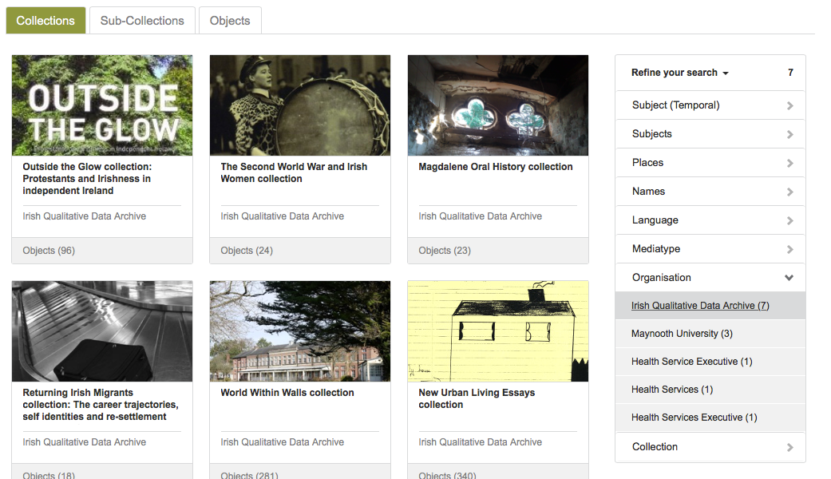
Our Data Sets

Slide 5
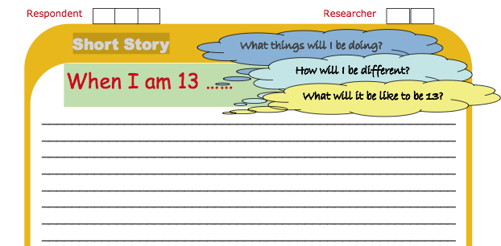
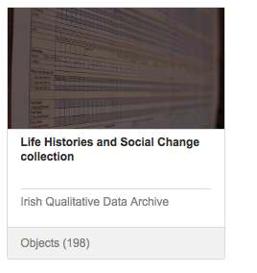
Our Data Sets
Wave 1 at 9 months, 122 parent/guardian interviews
Wave 1 at 9 years, 120 parentguardian and children interviews, worksheets and charts
Notes:
GUI is located at MUSSI (qual) and quant is located at UCD (ISDA)
GUI: Growing Up in Ireland is a longitudinal study which follows two cohorts of children, aged nine months and nine years. The study was officially launched in 2007 and will be completed in 2013.
Transcript of child interview, mainly in the 4,000 to 5,000 word range.
Transcript of parent interivew, in the 3,000 to 4,000 word range.
Time capsule which includes (in the order of the interview schedule):
Who is in my family;
4.Body image scale;
When I am 13 short story;
. Letter to the Minister for Children.
. Field notes, but not for all interviews.

Slide 6
Resources
IQDA Best Practice in Archiving Guide 2011 (with Tallaght West CDI)
1. Consent – examples of consent form
2. Anonymisation – guide and anonymisation tool
3. Depositor and end-user licenses
4. Access and user restrictions
https://www.maynoothuniversity.ie/iqda/data-resources/resources-researchers
Notes:
SLIDE: RESOURSES
Best Practice Guide
* is advisory; role is to educate data producers in the reduction on disclosure risk
* Each data set is different, so depositor may seek to amend or add to protocol
* Protocol includes systems to support robust and oversight of the anonymisation processes (and IQDA have developed a tool to assist with this)
* Goal is to ensure respondent confidentiality while maintaining sufficient detail to enable effective research.

Slide 7
Qualitative Research: Key Ethical Questions
1. Whether there is harm to the participants
2. Whether there is a lack of informed consent
3. Whether there is an invasion of privacy
4. Whether deception is involved.
Notes:
One size does not fit all
Need to develop an ethical protocol
Need to make decisions and document your decisions
These decisions are framed by the answers to these questions

Slide 8
Archiving Strategy for Restricted Data
Identify Sensitivity Levels
Apply appropriate strategy
Risk of Identification | Risk of Harm | Sensitivity Level | Strategy
Little | Low | Low | Open Access
Some | Low | Medium | Restricted Access
Any | High | High | Remove sensitive text or Embargo
Notes:
Not all data is restricted
Look to your consent form – what does it allow you to do? Do you have to keep the data from the public?
Always include an open access data on your consent form
Magdalene Laundaries data, in some cases participants are telling their story because they want to be publically identified with it.
ONE SIZE DOES NOT FIT ALL:
FIRST FOR EACH INTERVIEW CARRY OUT AN ASSESSMENT
1Risk of Identification:
Some people self-anonymise in interviews, don’t mention names, places, dates
Some interviews are very generic and non-specific or contain very little identificable information
Compare: Interview with returning migrants about their work lives (very generic) with life history data (multiple points of contact)
The CSO’s main reservation was that combining information points from a transcript might make it possible to identify a family. The information of concern included involvement in particular sports, number and gender of siblings, when parents were born, attendance at a Gaelscoil and particular achievements like winning competitions, even when details like names and exact dates were anonymised according to the protocols.
2. Risk of Harm:
Some data carry more risk of harm
High risk – illegal activity such as sex work or the Boston College interviews or risk of invasion of privacy, moral taboo, eg abortion interviewws
Low risk – eg interviews with women on experience working in IT
THEN ASSIGN A SENSITIVITY LEVEL
THEN APPLY AN APPROPERIATE STRATEGY
KEEP A RECORD OF THE DECISIONS YOU HAVE MADE
Under some circumstances it may be necessary to excise sections from transcripts, or to withhold individual transcripts from within a project, for example where sensitive text might expose participants to legal action, or “place them at risk of harm, scandal or ridicule” (Corti et al. 2000 [31]).
Other strategies for dealing with sensitive data may include:
Closure of materials for a specified period, agreed with the depositor
Restricted access, where certain materials are only available to particular kinds of researchers, and/or where requests for access are vetted by the depositor
WE are going to focus on the RISK OF IDENTIFICATION;
In particular how to use ANONYMISATION to reduce the risk

Slide 9
Anonymisation Overview
Remove major identifying data
Remove all identifying details
Replace with descriptions that reflect the significance of the original text within the context of the transcript
Keep a tracking table to record all changes and to link real names with pseudonyms
Indicate when a replacement has been made
Notes:
Remove major identifying data (real names, place and company names)
Remove all identifying details (names, street-names, real names, occupational details)
Replace with descriptions that reflect the significance of the original text within the context of the transcript
Keep a tracking table to record all changes and to link real names with pseudonyms (see 3. below

Slide 10
Anonmyisation – holistic approach
There was a table set out under a tree in front of the house, and the March Hare and the Hatter were having tea at it: a doremouse was sitting between them, fast asleep, and the other two were using it as a cushion, resting their elbows on it, and the talking over its head. `Very uncomfortable for the doremouse,' thought Alice; `only, as it's asleep, I suppose it doesn't mind.'

Slide 11
Anonmyisation – holistic approach
Name in transcript | Anomyised name | Nature of individual or place (eg interviewee, husband of, place of work, etc) | Special alerts or queries
Alice | @@Jane##
The Hatter | @@George##
the March Hare | @@Jim##
dormouse | @@gerbil##

Slide 12
Anonmyisation – Holistic Approach
There was a table set out under a tree in front of the house, and @@Jim##
and @@George## were having tea at it: a @@gerbil## was sitting between them, fast asleep, and the other two were using it as a cushion, resting their elbows on it, and the talking over its head. `Very uncomfortable for the @@gerbil##,' thought @@Jane##; `only, as it's asleep, I suppose it doesn't mind.'

Slide 13
Anonmyisation - Names
Case Study: Life History and Social Change consent form
“I was talking to my neighbour, Mary, and I said”
“I was talking to my neighbour, @@Sarah##, and I said”.
“I remember, De Valera was president at that time.”
Notes:
It may be necessary to anonymise these depending on context. The key question to consider is whether or not the organisation is unique enough for individuals to be identified through their association with it.
If you do anonymise the name of an organisation, do so by referring to its broad category e.g. @@Church choir##, or @@local football club##, and include an alert in the Anonymisation Table. As with names and places, provide sufficient information in your description to reflect the significance of the organisation in the context of the whole transcript.
Question: Would you anonymise GAA?
Question: Would you anonmyise Olympic Swimming Team?

Slide 14
Anonmyisation - Occupations
Case Study: Life History and Social Change consent form
“I was a nurse”
“I was the third secretary in the Department of Foreign Affairs ”
“I was @@a senior civil servant## ”

Slide 15
Anonmyisation - Places
Case Study: Life History and Social Change consent for
“We had the reception at Ballymascanlan hotel”
“We had the reception at @@a local hotel##”
Notes:
The kinds of placenames that should be anonymised will depend on context and may include: countries, cities, towns, villages, rural areas, schools and universities, places of work. The key question to be considered is whether or not there is a significant or long term attachment that would link an individual clearly to that place?
Describe the anonymised place according to its significance within the context of the transcript:
Nuts 3 Regional Divisions
1. Border: The counties of Cavan, Donegal, Leitrim, Louth, Monaghan, Sligo
2. West: The counties of Galway, Mayo and Roscommon
3. Midland: The counties of Laois, Longford, Offaly and Westmeath
4. Mid-East: The counties of Kildare, Meath and Wicklow
5. Dublin Region: the city of Dublin, and the counties of Dun Laoghaire-Rathdown, Fingal and South Dublin
6. South-East: The counties of Carlow, Kilkenny, South Tipperary, Waterford and Wexford
7. South-West: The counties of Cork and Kerry
8. Mid-West: The counties of Clare, Limerick and North Tipperary
9. Northern Ireland

Slide 16
Anonmyisation - Places
Case Study: Life History and Social Change consent for
“I was brought up in Killarney”
“I was brought up in @@Kilkeely, in the South-West##.”
Notes:
The kinds of placenames that should be anonymised will depend on context and may include: countries, cities, towns, villages, rural areas, schools and universities, places of work. The key question to be considered is whether or not there is a significant or long term attachment that would link an individual clearly to that place?
Describe the anonymised place according to its significance within the context of the transcript:
Nuts 3 Regional Divisions
1. Border: The counties of Cavan, Donegal, Leitrim, Louth, Monaghan, Sligo
2. West: The counties of Galway, Mayo and Roscommon
3. Midland: The counties of Laois, Longford, Offaly and Westmeath
4. Mid-East: The counties of Kildare, Meath and Wicklow
5. Dublin Region: the city of Dublin, and the counties of Dun Laoghaire-Rathdown, Fingal and South Dublin
6. South-East: The counties of Carlow, Kilkenny, South Tipperary, Waterford and Wexford
7. South-West: The counties of Cork and Kerry
8. Mid-West: The counties of Clare, Limerick and North Tipperary
9. Northern Ireland

Slide 17
Anonmyisation - Places
Case Study: Life History and Social Change consent for
“I went to The High School in Rathgar”
I went to @@a private secondary school in Dublin##”
Notes:
The kinds of placenames that should be anonymised will depend on context and may include: countries, cities, towns, villages, rural areas, schools and universities, places of work. The key question to be considered is whether or not there is a significant or long term attachment that would link an individual clearly to that place?
Describe the anonymised place according to its significance within the context of the transcript:
Nuts 3 Regional Divisions
1. Border: The counties of Cavan, Donegal, Leitrim, Louth, Monaghan, Sligo
2. West: The counties of Galway, Mayo and Roscommon
3. Midland: The counties of Laois, Longford, Offaly and Westmeath
4. Mid-East: The counties of Kildare, Meath and Wicklow
5. Dublin Region: the city of Dublin, and the counties of Dun Laoghaire-Rathdown, Fingal and South Dublin
6. South-East: The counties of Carlow, Kilkenny, South Tipperary, Waterford and Wexford
7. South-West: The counties of Cork and Kerry
8. Mid-West: The counties of Clare, Limerick and North Tipperary
9. Northern Ireland
anonymising is a process, a discussion
maintain meaningful information
log edits

Slide 18
Enabling re-use: Contextual Information
Original grant application
* End of award report
* Description of methodology
* Interview schedule(s)/topic guide
* Questionnaire
* Observation checklist
* Interviewer instructions/prompt cards
* Matrices
* Tree diagrams
* Information about equipment used (e.g. recording equipment)
* Other background information
* Details of missing information
* Correspondence
* Speaker markers in text, typically associated with internal metadata; question or thematic markers in text; cross-reference of text to audio material.
* Explanations of any short hand or researcher notes used in the data- set

